Slide 1

Python 409
ด้วยรักและพักเถอะ

Slide 2
Problem Solving

Slide 3
Variable Scope

Slide 4
Recursion

Slide 5
List comprehension

Slide 6
Python Dictionary & Set

Slide 7
Regular expression
[ ]
:
A set of Characters
“[ a - m ]”

Slide 8
Regular expression > RegEx Function
re.findall
Returns a list containing all matches
re.search
Returns a Match object if there is a match
anywhere in the string
re.split
Returns a list where the string has been split at
each match
re.sub
Replaces one or many matches whit a string

Slide 9
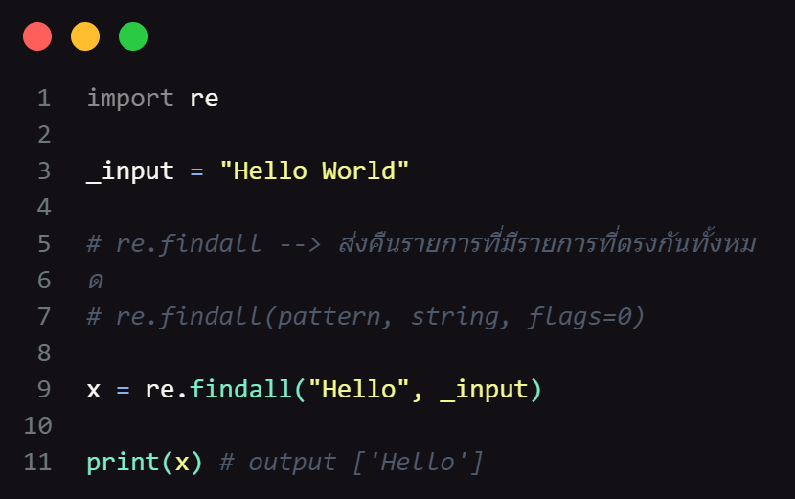
re.findall
Returns a list containing all matches

